Slide 1
Introduction to YARN

Slide 2
Limitations in Map Reduce – 1: (YARN Vs Map-Reduce-1)
Map-Reduce-1 has two types of Daemons to control the job execution process:
Jobtracker
It is a single master process, which coordinates all jobs running on the cluster and assigns map and reduce tasks to run on the Tasktrackers.
It takes care of job scheduling ( matching tasks with tasktrackers)
It takes care of task progress monitoring
Keeping track of tasks
Restarting failed or slow tasks
Doing task book-keeping such as maintaining counter totals
It stores the job history for completed jobs (Timeline server in YARN )
If a task fails, the jobtracker can reschedule it on a different tasktracker
Tasktracker
It runs tasks and sends progress reports to the jobtrackers, which keeps a record of the overall progress of each job (Node Manager in YARN)
Resource Manager and Application master in YARN

Slide 3
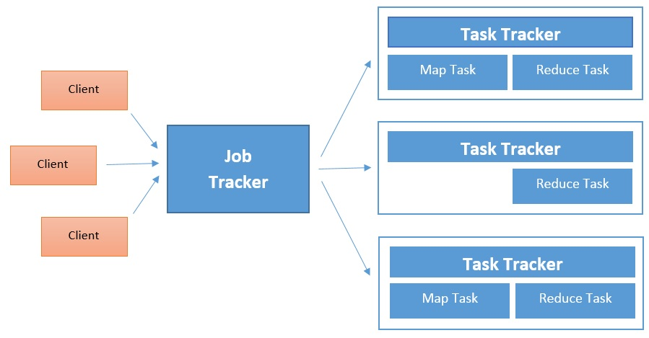
Limitations in Map Reduce – 1: YARN Vs Map-Reduce-1
Classical Version of Apache Hadoop (Map-Reduce-1)

Slide 4
Limitations in Map Reduce – 1
Large Hadoop cluster has limitation in scalability → single Job Tracker
According Yahoo! → a cluster of 5000 nodes and 40,000 task are running
Solution – 1:
Smaller and less-powerful clusters has to be created and maintained
The smaller and larger Hadoop clusters had never used their computational resources with optimum efficiency
In Hadoop Mapreduce, the computational resources on each slave node are divided by cluster administrator into fixed-number of map and reduce slots
A node cannot run more map tasks than map slots at any given moment, even if no reduce tasks are running.
It harms the cluster utilization because when all map slots are taken (and we still want more), we cannot use any reduce slots, even if they are available, or vice versa
Solution – 2:
An alternative Programming model (such as graph processing provided by Apache Giraph) → designed to run mapreduce jobs only.

Slide 5
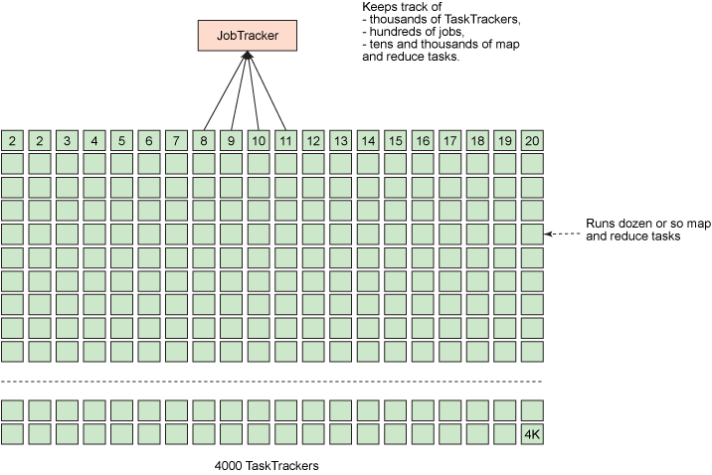
Limitations in Map Reduce – 1
Busy JobTracker on large Apache Hadoop Cluster:

Slide 6
Limitations in Map Reduce – 1
High Availability (HA):
State needed for another daemon to take the work needed to provide the service, in the event of the service daemon fails.
Large amount of rapidly changing complex state in the jobtracker’s memory makes difficult to retrofit HA into the jobtracker sevice.
Responsibilities of jobtracker are split into Resource Manager and Application Master in YARN.
Utilization:
Tasktracker in Map Reduce -1 is configured with a static allocation of fixed-size slots.
Node Manager in YARN manages a pool of resources. Not Fixed number of designated slots
Application in YARN can make request for what type of resources are needed.
Multitenancy:
It opens up Hadoop to other types of distributed applications beyond mapreduce

Slide 7
Introduction to YARN
YARN
Yet Another Resource Negotiator
Arun Murthy created the original JIRA in 2008
YARN Released October 2013 with Apache Hadoop -2.0
YARN separates the resource management and processing components in Hadoop-2.0
Hadoop’s Cluster resource management system
Introduced in Hadoop-2 to improve the mapreduce implementation
It also supports other distributed computing paradigms as well
YARN Provides APIs for requesting and working with cluster resources.
These APIs are not directly used by user code
YARN is treated as cluster compute layer and HDFS is treated as cluster storage layer

Slide 8
Hadoop 2.0: From Batch-only to Multi-Workload
Single Use System
Batch Apps
Multi Purpose Platform
Batch, Interactive, Online, Streaming, …
HADOOP 1.0
HADOOP 2.0
MapReduce
(data processing)
Others
(data processing)
MapReduce
(cluster resource management
& data processing)
YARN
(cluster resource management)
HDFS
(redundant, reliable storage)
HDFS2
(redundant, reliable storage)

Slide 9

Key Driver Of Hadoop Adoption: Enterprise Data Lake
Flexible Enables other purpose-built data processing models beyond MapReduce (batch), such as interactive and streaming
Efficient Double processing IN Hadoop on the same hardware while providing predictable performance & quality of service
Shared Provides a stable, reliable, secure foundation and shared operational services across multiple workloads
Data Processing Engines Run Natively IN Hadoop
BATCH
MapReduce
INTERACTIVE
Tez
ONLINE
HBase, Accumulo
STREAMING
Storm
IN-MEMORY
Spark
GRAPH
Giraph
OTHERS
YARN: Cluster Resource Management
HDFS: Redundant, Reliable Storage

Slide 10
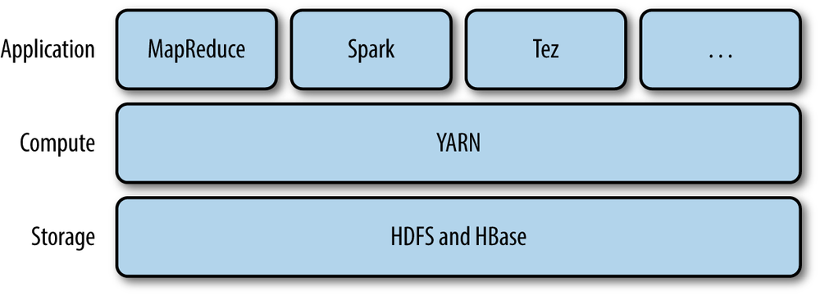
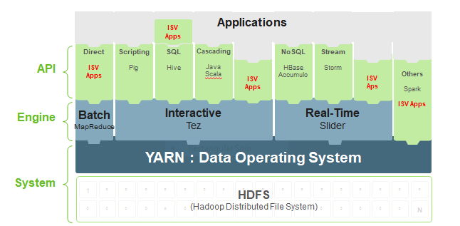
Introduction to YARN

Slide 11
Introduction to YARN
YARN provides it services with two daemons:
Resource Manager (One per Cluster)
To Manage the usage of resources in cluster
Node Manager (All the nodes in cluster)
To launch and monitor containers.
A Container executes an application-specific process with a constrained set of resources (memory, cpu, etc..)

Slide 12
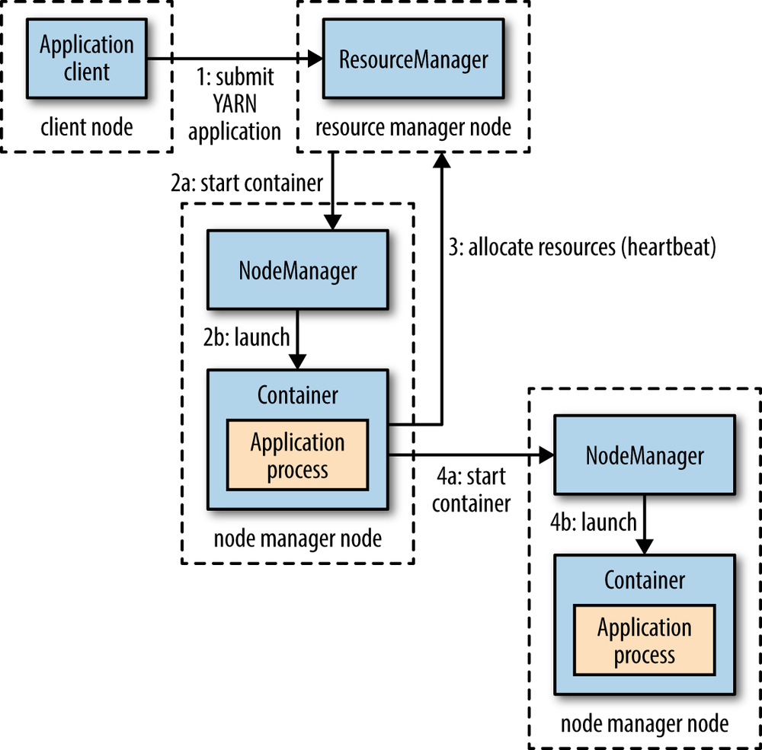
Introduction to YARN
Anatomy of YARN Application Run
Step – 1:
A client contacts the resource manager
and asks it to run an application master
process
Step – 2:
The resource manager then finds a
node manager that can launch the
application master in a container

Slide 13
Introduction to YARN
Step – 3 & 4:
It could simply run a computation in the container. it is running in and return the result to the client. Or it could request more containers from the resource managers and use them to run a distributed computation
Hadoop’s RPC is used to pass status updates and results back to the client, but these are specific to the application

Slide 14
Introduction to YARN
Resource Requests:
It has flexible model for making resource requests
A request for a set of containers
can express the amount of computer resources are required for each container (memory and CPU),
Locality constraints for the containers in the request → bandwidth efficiency
Locality constraints can be used to request a container on a specific node or rack, or anywhere on the cluster (off-rack).
What happens if locality constraint is not met????
Not met means → no allocation is made or the constraint can be loosend → How did the YARN solve this problem
Example:
If a specific node was requested but it is not possible to start container on it
YARN will try to start a container on a node in the same rack or if that’s not possible, on any node in the cluster

Slide 15
Introduction to YARN
Resource Requests:
The common case of launching a container to process
The application will request a container on one of the nodes hosting the block’s three replicas, or
On a node in one of the racks hosting the replicas, or
Failing that, on any node in the cluster
YARN application can make resource requests at any time while it is running.
More dynamic approach whereby it requests more resources dynamically to meet the changing needs of the application
Example:
Map-Reduce : map and reduce
Map task containers are requested up-front, but the reducer task containers are not started until later
If any task fails, additional containers will be requested so the failed task can be re-run

Slide 16
Introduction to YARN
Application Lifespan:
The lifespan of a YARN application can vary dramatically
Short-lived Applications
Long-lived Applications
Categorize the applications in terms of how they map to the jobs that users run → Three models
One Application for one user job
Mapreduce used this approach
One Application for workflow or user session jobs
Spark uses this approach
More efficient
Potential to cache intermediate data between jobs
Long – running application that is shared by different users
An application often acts in some kind of coordination role
Apache Slider use this approach
Impala uses this approach

Slide 17
Introduction to YARN
Building YARN Applications:
We can use existing application to write YARN application, instead of writing YARN application from scratch.
Spark or Tez → execution of DAG of jobs on YARN
Apache Slider
Apache Twill → simple programming model for developing distributed application on YARN
Distributed Shell application → part of the YARN to write distributed applications

Slide 18
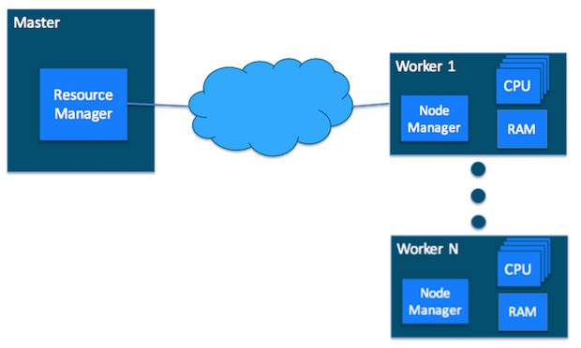
YARN Cluster basics
Master host with ResourceManager and Worker hosts with NodeManager

Slide 19
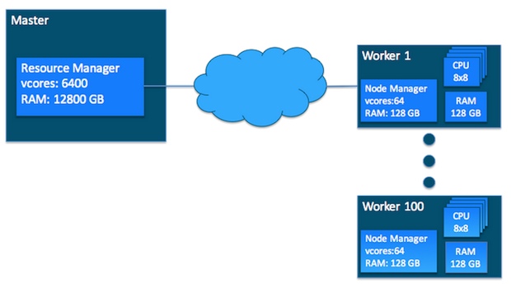
YARN Cluster basics
YARN Requires a Global View:
two Resources:
vcores (usage share of CPU core) and memory
Each NodeManager tracks its own local resources and communicates its resource configuration to the ResourceManager.
Resource Manager keeps a running total of the cluster’s available resources
The ResourceManager knows how to allocate resources as they are requested.

Slide 20
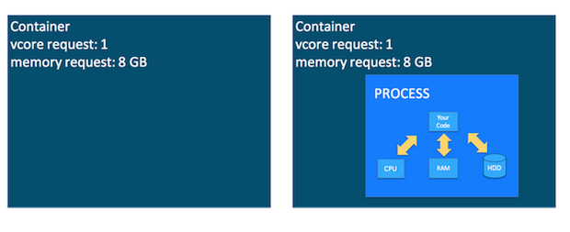
YARN Cluster basics
Containers:
a container as a request to hold resources on the YARN cluster.
Once a hold has been granted on a host, the NodeManager launches a process called a task.
An application is a YARN client program that is made up of one or more tasks
For each running application, a special piece of code called an ApplicationMaster helps coordinate tasks on the YARN cluster.
The ApplicationMaster is the first process run after the application starts.

Slide 21
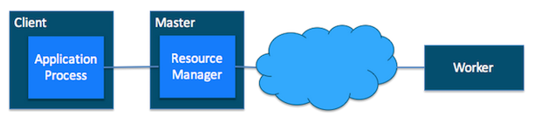
YARN Cluster basics
The application starts and talks to the ResourceManager for the cluster:

Slide 22
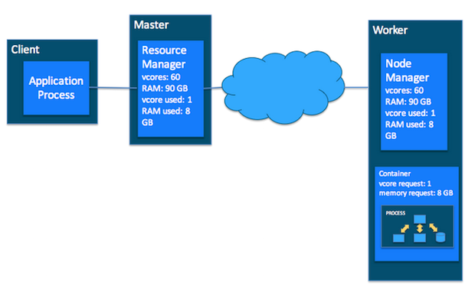
YARN Cluster basics
The ResourceManager makes a single container request on behalf of the application

Slide 23
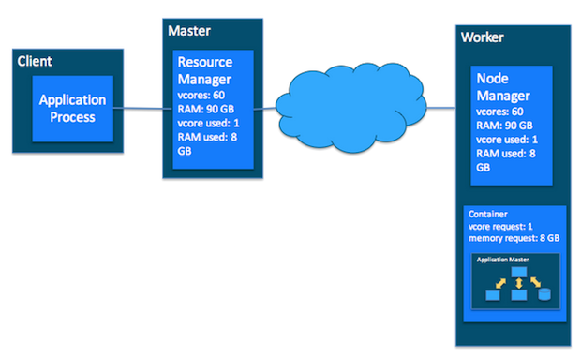
YARN Cluster basics
The ApplicationMaster starts running within that container

Slide 24
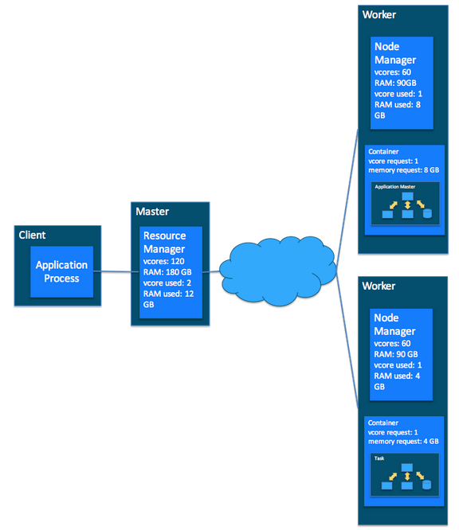
YARN Cluster basics
The ApplicationMaster requests subsequent containers from the ResourceManager that are allocated to run tasks for the application.

Slide 25
YARN Cluster basics
Once all tasks are finished, the ApplicationMaster exits. The last container is de-allocated from the cluster.
The application client exits.

Slide 26
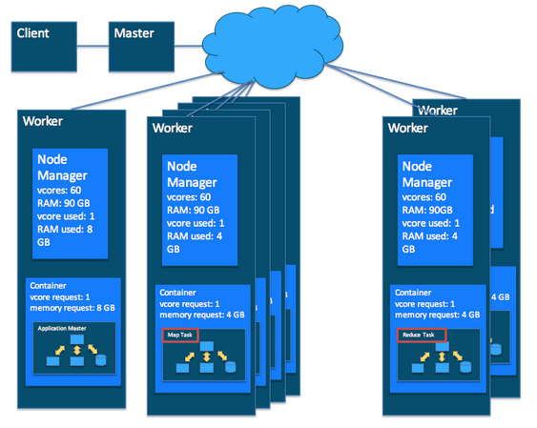
YARN Cluster basics
Putting it Together: MapReduce and YARN

Slide 27
Scheduling in YARN
In an ideal world, the requests that a YARN application makes would be granted immediately. But this is a not case in real world
The resources are limited, and on a busy cluster, an application will often need to wait to have some of its requests fulfilled.
It is the job of the YARN scheduler to allocate resources to applications according to some defined policy.
Scheduling in general is a difficult problem and there is no one “best” policy.
Hence, YARN provides a choice of schedulers and configurable policies.

Slide 28
Scheduling in YARN
Three schedulers are available in YARN
FIFO scheduler
Capacity Scheduler
Fair Scheduler
FIFO Scheduler:
The FIFO Scheduler places applications in a queue and runs them in the order of submission (first in, first out).
Requests for the first application in the queue are allocated first;
Once its requests have been satisfied, the next application in the queue is served, and so on.
It is simple to understand
No need of any configuration.
It is not a best choice for shared clusters.
Large applications will use all the resources in a cluster, so each application has to wait its turn. → go for capacity or fair schedulers for long running app.

Slide 29
Scheduling in YARN
Capacity Scheduler:
A separate dedicated queue allows the small job to start as soon as it is submitted.
Cost overhead.
Fair Scheduler:
No need of reservation of memory
it will dynamically balance resources between all running jobs.
Just after the first (large) job starts, it is the only job running, so it gets all the resources in the cluster.
When the second (small) job starts, it is allocated half of the cluster resources so that each job is using its fair share of resources.
There is a lag between the time the second job starts. → when it receives its fair share, since it has to wait for resources to free up as containers used by the first job complete.

Slide 30
Scheduling in YARN
Fair Scheduler:
After the small job completes and no longer requires resources, the large job goes back to using the full cluster capacity again.
The overall effect is both high cluster utilization and timely small job completion.

Slide 31
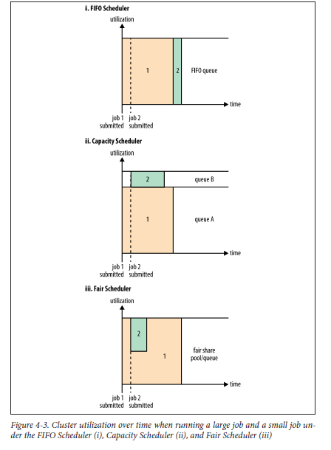
Scheduling in YARN

Slide 32


